Slide 1
WHY ELECTRONICS NEED ...
New Paths in Math

Slide 3
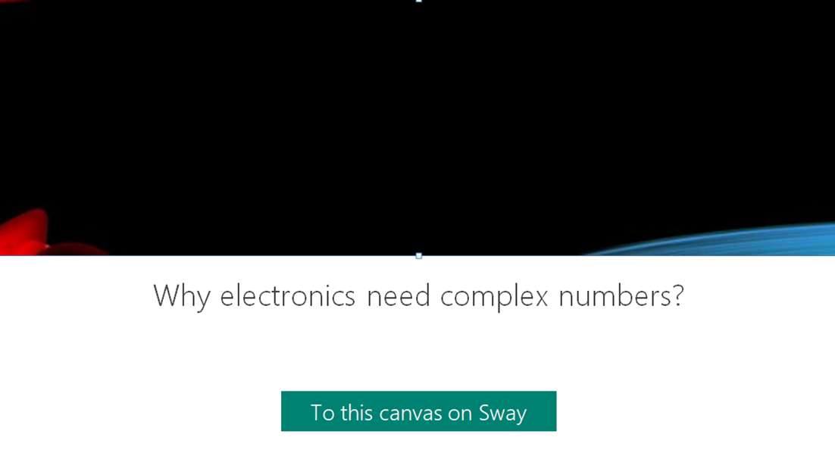

Slide 5
THANK YOU!
This publication reflects the views only of the author, and the Commission cannot be held responsible for any use which may be made of the information contained therein.

